Slide 1
Object Oriented Development (CIS1056-N)
UML Class Diagrams and Test Cases

Slide 2
Java Classes
Classes can be complex structures.
A range of variables and methods with types, parameters and more.
How can we represent these classes simply and consistently?
UML Class Diagrams!

Slide 3
Showing a class in UML notation
ClassName
ClassName
Attribute Attribute
ClassName
Operation Operation
ClassName
Attribute Attribute
Operation Operation

Slide 4
Simple example: Managing a subreddit
Subreddit
Post

Slide 5
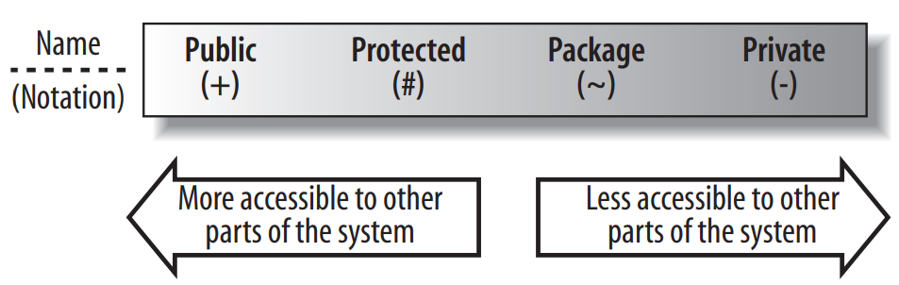
Visibility
Classes consist of attributes and operations
What they are and what they do
A class may not want any of its attributes or operations to be usable by other classes
This can be achieved through the visibility of that code

Slide 6
Visibility (part 2.)
There are 4 visibility modifiers: public, protected, package (no modifier in Java) and private.
Typically, these visibility characteristics will be used to control access to both attributes, operations, and sometimes even classes (more on this later in the semester).
Modifier | Class | Package | Subclass | World
public | Y | Y | Y | Y
protected | Y | Y | Y | N
no modifier | Y | Y | N | N
private | Y | N | N | N
See https://docs.oracle.com/javase/tutorial/java/javaOO/accesscontrol.html

Slide 7
Visibility (part 3.)
Subreddit
- name: String + publicURL: URL - posts: Post[] mods: User[] …
+ addPost(newPost: Post, OP: User): void - removePost(postToRemove: Post): void + search(searchString: String): Post …
Use private where possible; less access means greater control and safety

Slide 8
Class State: Attributes
A class’s attributes are the pieces of information that represent the state of an object.
Subreddit
-name: String +publicURL: URL
1
*
Post
~posts
An attribute by association

Slide 9
Class State: Attributes
A class’s attributes are the pieces of information that represent the state of an object.
import java.net.URL;
public class BlogAccount
{ private String name;
public URL publicURL;
Post[] posts;
}
Subreddit
- name: String + publicURL: URL ~ posts: Post[]
Post

Slide 10
Multiplicity
Sometimes an attribute will represent more than one object.
In fact, an attribute could represent any number of objects of its type.
Subreddit
-name: String +publicURL: URL -posts: Post[] -mods: Moderators[5]
Post
-comments: ArrayList<Comment>

Slide 11
Attribute properties
As well as visibility, a unique name, and a type, there is also a set of properties that can be applied to attributes to completely describe an attribute’s characteristics.
What other non-access modifiers can we use when declaring an attribute in Java?

Slide 12
A final attribute
Often referred to as a CONSTANT.
public class HelloUML
{
private final String LECTURER = “Chris Curry";
}
HelloUML
-LECTURER: String = “Chris Curry” {final}

Slide 13
A readOnly attribute
Something a bit more nuanced. Sometimes we only want to initialise an attribute through a constructor, and then never modify.
public class Moderator {
private final String name;
public Moderator(String name) {
this.name = n;
}
}
Moderator
-name: String {readOnly}
+Moderator(name: String)

Slide 14
Class Behaviour: Operations (part 1.)
A class’s operations describe what a class can do but not necessarily how it is going to do it.
Operations in a UML a class diagram are specified with at least a visibility property, a name, a pair of parentheses for parameters (may be empty), and a return type.
Subreddit
-name: String +publicURL: URL -posts: Post[] -mods: Moderators[5]
+addPost(): void

Slide 15
Class Behaviour: Operations (part 2.)
Subreddit
-name: String +publicURL: URL -posts: Post[] -mods: Moderators[5]
+addPost(): void
Visibility
Return Type
Name
Parameters

Slide 16
Parameters
Subreddit
-name: String +publicURL: URL -posts: Post[] -mods: Moderators[5]
+addPost(newPost: Post, mod: Moderator): void
Parameters are used to specify the information provided to an operation to allow it to complete its job.
public class Subreddit {
// attributes here
public void addPost(Post newPost, Moderator mod){
// implementation here
} }

Slide 17
Return Types
Subreddit
-name: String +publicURL: URL -posts: Post[] -mods: Moderators[5]
+addPost(newPost: Post, mod: Moderator): boolean
A return type is specified after a colon at the end of an operation’s signature.
public class Subreddit {
// attributes here
public Boolean addPost(Post newPost, Moderator mod){
// implementation here
return true;
} }

Slide 18
Return Types: Constructor
There is one exception where you don’t need to specify a return type: when you are declaring a class’s constructor.
A constructor creates and returns a new instance of the class that it is specified in, therefore, it does not need to explicitly declare any return type.
Moderator
-name: String {readOnly}
+Moderator() +Moderator(name: String)
Method name(s) match class name, therefore constructor. No need for return type.

Slide 19
Static (part 1.)
The static modifier can be applied to attributes and operations.
Using static, how can we keep a count of all Subreddits?
Subreddit
-name: String +publicURL: URL -posts: Post[] -mods: Moderators[5]
+addPost(newPost: Post, mod: Moderator): boolean

Slide 20
Static (part 2.)
Subreddit
-name: String +publicURL: URL -posts: Post[] -mods: Moderators[5] -subCounter: int
+Subreddit(n: String, url: URL) +addPost(newPost: Post, mod: Moderator): Boolean
Increment subCounter in constructor.

Slide 21
public class Subreddit {
// Attributes
private String name;
public URL publicURL;
private Post[] posts;
private Moderator[] mods = new Moderator[5];
private static int subCounter;
// Constructor
public Subreddit(String n, URL url) {
this.name = n;
this.publicURL = url;
subCounter++;
}
// Operations
public Boolean addPost(Post np, Moderator mod){
// implementation here
return true;
}
}
Subreddit
-name: String +publicURL: URL -posts: Post[] -mods: Moderators[5] -subCounter: int
+Subreddit(n: String, url: URL) +addPost(np: Post, mod: Moderator): Boolean

Slide 22
Relationships
In addition to primitive types, classes may work with other classes
These interactions can be very brief, as in one class needing to be aware of another to achieve some aim
Or much more significant, such a class built entirely from instances of another
In a class diagram, these interactions can be modelled as UML Relationships

Slide 23
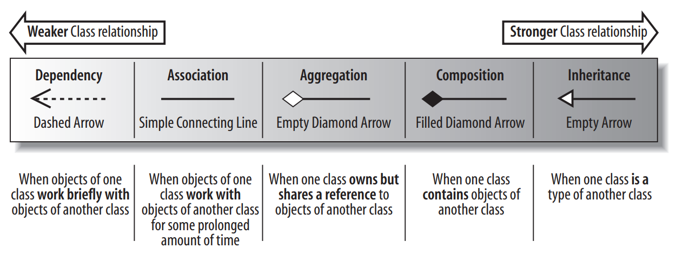
Class Relationships
There are 5 relationships in UML Class Diagrams
Each represents a different strength of interaction

Slide 24
Dependency
A dependency between two classes declares that a class needs to know about another class to use objects of that class.
The UserInterface and Post classes simply work together at the times when the user interface wants to display the contents of a post.
In class diagram terms, the two classes of object are dependent on each other to ensure they work together at runtime.
UserInterface
+display(): void
Post

Slide 25
Association
Association means that a class will actually contain a reference to an object, or objects, of the other class in the form of an attribute.
If you find yourself saying that a class works with an object of another class, then the relationship between those classes is a great candidate for association rather than just a dependency.
Subreddit
-publicUrl: URL
URL

Slide 26
Aggregation
Aggregation is really just a stronger version of association and is used to indicate that a class actually owns but may share objects of another class.
A subreddit owns its posts, and even though they might share them with other subreddits, in the end, its posts are its own.
The power to remove a post remains with the subreddit.
Subreddit
- posts: Post[]
Post

Slide 27
Composition
Composition is an even stronger relationship than aggregation, although they work in very similar ways.
Comments are part of the post itself, they would not exist outside of this. If a post were to be deleted, so would the comments.
Post
- comments: ArrayList<Comment>
Comment

Slide 28

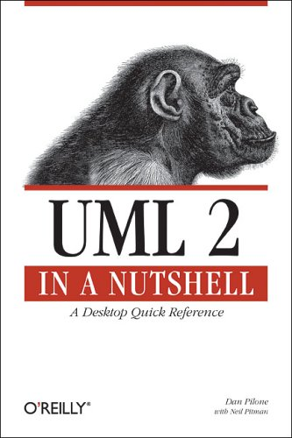
Read more
The following resources are available at the library to help with UML class diagrams.

Slide 29
Test Cases

Slide 30
Testing
Writing code is only one part of creating programs.
You can write good code that compiles and returns the wrong values.
You can write code that works most of the time.
How can you be sure that your program does what it is supposed to?
You test it!

Slide 31
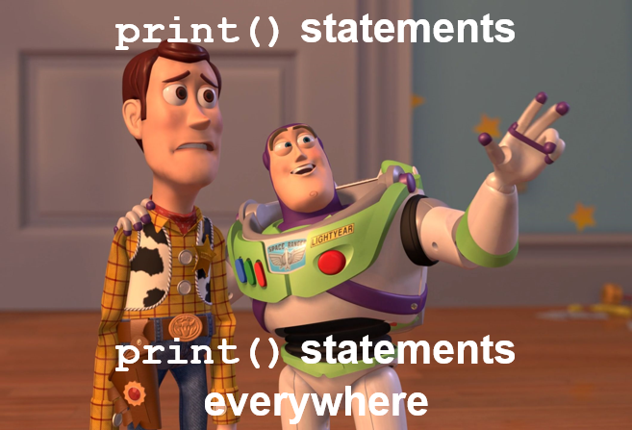
White-box and Black-box testing
Testing falls into two main categories:
White-box (as you develop, piece-by-piece)
Adding print statements to your code
Utilising debugging environments (e.g. by setting breakpoints, stepping through etc.)
Black-box (after you’ve finished a block, whole blocks at a time)
Applies to functions or blocks.
Case tests with known results.

Slide 32
White-Box Testing
White-box testing is typically performed alongside development.
Relies on use of println statements to output variable data.
Breakpoints and Debug mode.
Use this form of testing to examine how your program is running:
Partial calculations
Information about a loop
Outputting locations from your program
“HERE@addComment()”
A good way to check parts of the program in isolation

Slide 33
Black-box Testing
Black-box testing is a more formal approach.
You treat your program as a “black-box”: input goes in, output gets returned, no thinking about how the program does it.
These tests aim to evaluate the whole program:
Are the outputs correct for the input?
Is the program output clear and easy to understand?
Does the program work for a range of values
Including “bad” inputs!
Black-box testing can be planned at the start of projects: you know what you want the program to do

Slide 34
Testing strategy considerations
You should test your program code for correctness…
With valid data.
With invalid data.
With respect to boundary tests on iterations (don’t go out of bounds!)
You should test your program code for usability…
Assess the user’s understanding. Are you making sensible prompts?
Assess interface design (also applies to command-line applications).
Could there be unexpected user interactions? What if their head hits the keyboard?

Slide 35
Case testing
Unit testing tests functions as independent entities. We will cover this in Semester 2!
Prepare your test cases carefully:
List valid inputs to test and expected results.
List invalid inputs to test and expected results.
Make each test unique to a function or code block.
Do not forget to boundary check loops (avoid going out of bounds).
Truth tables can be used to check conditional statements with every combination of True / False.

Slide 36
Coding challenge
Write a simple program that prompts the user to enter a positive number. Handle all possible exceptions, then print the number.

Slide 37
Let’s write some black-box tests for…
import java.util.Scanner;
public class Number {
public static void main(String[] args) {
int num = getPositiveNum();
System.out.printf("You chose: %d\n", num);
}
static int getPositiveNum(){
Scanner scan = new Scanner(System.in);
int num = 0;
while (true) {
try {
System.out.print("Please enter a positive number: ");
num = scan.nextInt();
break;
}
catch (java.util.InputMismatchException e) {
System.out.println("Try again :-/");
scan.nextLine(); // clear input buffer
}
} return num;
}
}

Slide 38
getPositiveNum() test cases
ID | Description | Steps | Expected | Actual | Result | Comment
GP1

Slide 39
getPositiveNum() test cases
ID | Description | Steps | Expected | Actual | Result | Comment
GP1 | Test valid input. | Launch program. Input “5”. | You chose: 5

Slide 40
getPositiveNum() test cases
ID | Description | Steps | Expected | Actual | Result | Comment
GP1 | Test valid input. | Launch program. Input “5”. | You chose: 5 | You chose: 5 | PASS | -

Slide 41
getPositiveNum() test cases
ID | Description | Steps | Expected | Actual | Result | Comment
GP1 | Test valid input. | Launch program. Input “5”. | You chose: 5 | You chose: 5 | PASS | -
GP2 | Test no input. | Launch program. Press ENTER. | Try again :-/ | Try again :-/ | PASS | -

Slide 42
getPositiveNum() test cases
ID | Description | Steps | Expected | Actual | Result | Comment
GP1 | Test valid input. | Launch program. Input “5”. | You chose: 5 | You chose: 5 | PASS | -
GP2 | Test no input. | Launch program. Press ENTER. | Try again :-/ | Try again :-/ | PASS | -
GP3 | Test string input. | Launch program. Input “Five”. | Try again :-/ | Try again :-/ | PASS | -

Slide 43
getPositiveNum() test cases
ID | Description | Steps | Expected | Actual | Result | Comment
GP1 | Test valid input. | Launch program. Input “5”. | You chose: 5 | You chose: 5 | PASS | -
GP2 | Test no input. | Launch program. Press ENTER. | Try again :-/ | Try again :-/ | PASS | -
GP3 | Test string input. | Launch program. Input “Five”. | Try again :-/ | Try again :-/ | PASS | -
GP4 | Test float input. | Launch program. Input “3.14”. | Try again :-/ | Try again :-/ | PASS | -

Slide 44
getPositiveNum() test cases
ID | Description | Steps | Expected | Actual | Result | Comment
GP1 | Test valid input. | Launch program. Input “5”. | You chose: 5 | You chose: 5 | PASS | -
GP2 | Test no input. | Launch program. Press ENTER. | Try again :-/ | Try again :-/ | PASS | -
GP3 | Test string input. | Launch program. Input “Five”. | Try again :-/ | Try again :-/ | PASS | -
GP4 | Test float input. | Launch program. Input “3.14”. | Try again :-/ | Try again :-/ | PASS | -
GP5 | Test negative input. | Launch program. Input “-8”. | Try again :-/

Slide 45
getPositiveNum() test cases
ID | Description | Steps | Expected | Actual | Result | Comment
GP1 | Test valid input. | Launch program. Input “5”. | You chose: 5 | You chose: 5 | PASS | -
GP2 | Test no input. | Launch program. Press ENTER. | Try again :-/ | Try again :-/ | PASS | -
GP3 | Test string input. | Launch program. Input “Five”. | Try again :-/ | Try again :-/ | PASS | -
GP4 | Test float input. | Launch program. Input “3.14”. | Try again :-/ | Try again :-/ | PASS | -
GP5 | Test negative input. | Launch program. Input “-8”. | Try again :-/ | You chose: -8 | FAIL | try: should also check for an int > 0

Slide 46
Summary
UML Class Diagrams can be used to plan, communicate and design Java classes
Attributes, Operations, Visibilities and Relations all represented
Testing is a key stage of development
Ensures your program operates correctly
White box testing during development
Black box when the program is complete

Slide 47
Any Questions?

